Slide 1
Cloudburst Prediction System
PIP4004 - UNIVERSITY PROJECT
Review-2
Batch Number : CSE_CDV_CAP_02
Roll Number | Student Name
20211CDV0033 | RAJESHWARI C RAIKAR
20211CDV0034 | NISHA L
20211CDV0041 | KATTA VINOD KUMAR
20211CDV0055 | ARUTH RAJ P
20211CDV0056 | K VISHNU VARDHAN
Under the Supervision of,
Mr. RAJAN THANGAMANI,
Assistant Professor,
School of Computer Science and Engineering,
Presidency University,
Bangalore-560064.
Name of the Program: B.TECH COMPUTER SCIENCE AND TECHNOLOGY [DEVOPS]
Name of the HoD: Dr. S PRAVINTHRAJA
Name of the Program Project Coordinator: SUMA N G
Name of the School Project Coordinators: Dr. Sampath A K / Dr. Abdul Khadar A / Mr. Md Ziaur Rahman

Slide 2
Introduction
Cloudbursts are extreme weather events involving excessive rainfall within a short period.
They are unpredictable and often lead to flash floods, landslides, and infrastructure damage, especially in mountainous and hilly regions.
Traditional weather forecasting struggles to accurately predict cloudbursts due to the dynamic nature of atmospheric conditions.
Machine learning models provide a data-driven approach to analyzing weather parameters.
These models can improve cloudburst prediction accuracy, helping in disaster preparedness and mitigation.

Slide 3
Literature Review
Author(s) & Year | Title | Key Findings | Methodology Used
Sivaprakash et al. (2024) | Cloudburst Prediction System (CBPS) | Developed a system integrating machine learning models with satellite imagery and weather radar for real-time cloudburst predictions. | Machine Learning (Random Forest), Data Collection from meteorological sources, Real-time Prediction Models​.
Girish et al. (2024) | The Cloudburst Prediction System | Designed a predictive model using neural networks and ensemble learning techniques for forecasting cloudbursts. | Neural Networks, Feature Engineering, Real-time Data Processing, IoT Sensors​.
Telsang et al. (2024) | Cloudburst Prediction System Using Machine Learning | Compared multiple ML models (SVM, Decision Tree, Logistic Regression) and achieved 96% accuracy with SVM. Integrated real-time weather API for cloudburst forecasting. | Support Vector Machine (SVM), Decision Trees, Logistic Regression, Weather API Integration​.

Slide 4
Literature Review contd..
Author(s) & Year | Title | Key Findings | Methodology Used
Bartwal et al. (2024) | Rainfall Prediction Using Machine Learning | Used Theil-Sen regression and XGBoost for accurate rainfall prediction. Found Random Forest and XGBoost to be the most effective models. | Theil-Sen Regression, XGBoost, Random Forest​.
Karunanidy et al. (2023) | Cloudburst Prediction in India Using ML | Evaluated different ML models for cloudburst detection in India, highlighting the need for region-specific training data. | Random Forest, CatBoost, XGBoost, Decision Trees​.
Sebastian et al. (2023) | AI for Cloudburst Forecasting | Proposed an AI-powered early warning system integrating meteorological data and deep learning models. | AI-based Forecasting, Deep Learning, Sensor Networks​.

Slide 5
Existing method Drawback
Works poorly with large datasets.
Limited spatial resolution for small-scale cloudbursts.
Requires specialized expertise to interpret results.
Requires high computational power (not suitable for real-time predictions in local setups).
Predictions are not always accurate for localized cloudbursts (resolution issues).
Cannot capture complex dependencies between multiple weather parameters.

Slide 6
Advantages of Random-Forest Model
Handles Missing & Unbalanced Data Well
Faster Training Compared to SVM & Neural Networks
Works Well with Small to Medium-Sized Datasets
Handles Non-Linearity Well
Robust to Noise & Overfitting (Compared to Decision Trees)
Feature Importance Analysis.

Slide 7
Proposed Method
Data Collection & Preprocessing:
Sources:
Station-based data
Radar data
Satellite data
APIs: OpenWeatherMap, IMD
Parameters Captured:
Temperature, humidity, pressure, wind speed, rainfall, cloudiness (with timestamp and geo-tag)
Preprocessing:
Data normalization and scaling
Missing value imputation
Time alignment for time-series modeling

Slide 8
Proposed Method
2. Feature Engineering & Labeling
Feature Engineering:
Extract meteorological patterns (dew point, pressure gradients, etc.)
Labeling:
Target variable labeled from disaster records (cloudburst or not)
Time-stamped and geo-tagged
3. Machine Learning Model - Random Forest Classifier
Train-Test Split (80-20%) : Splits data into training and testing sets.
Random Forest Classifier → Uses an ensemble of decision trees for classification.
4. Cloudburst Risk Prediction
Load Pre-trained Model & Scaler from .pkl files.
Feature Transformation using the saved MinMaxScaler.
Model Prediction : Predicts "High Risk" or "Low Risk" based on real-time weather conditions.

Slide 9
Proposed Method
5. Geo-Informatics Risk Visualization
GIS Mapping:
Layers stacked: elevation, rainfall, infrastructure
Interface:
Analyst views spatial impact via dashboard
Visualization Tools:
Power BI for charts
React.js for frontend dashboard integration
6. Cloud Deployment & Scalability
Infrastructure:
Hosted on AWS EC2, uses AWS Lambda/S3 optionally
Security:
HTTPS
API rate limits
Authentication
Scalability:
Handles large inputs and expanding geographies

Slide 10
Objectives
Early Warning System – Provide real-time alerts for potential cloudbursts to minimize loss of life and property.
High-Accuracy Prediction – Utilize AI/ML models and meteorological data for precise cloudburst forecasting.
Real-Time Data Integration – Collect and process satellite, radar, and IoT sensor data for live monitoring.
Risk Assessment and Mapping – Identify high-risk regions using GIS-based mapping and predictive analytics.

Slide 11
Objectives contd..
Decision Support for Authorities – Assist disaster management agencies with actionable insights.
User-Friendly Interface – Provide interactive dashboards for visualization and accessibility via web and mobile.
Scalable and Adaptive System – Continuously update and improve the model using new weather patterns and historical data.

Slide 12
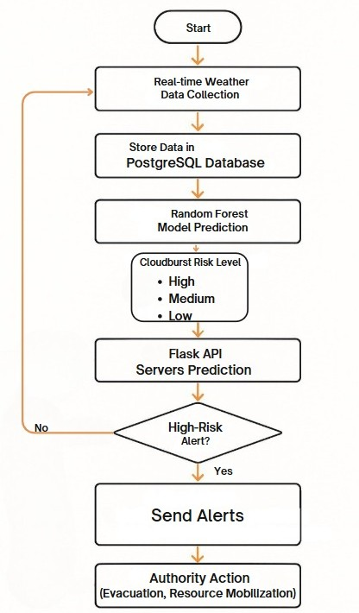
Methodology/Modules
The workflow for a Cloudburst Prediction system involves:
Fetch city & weather data
Store weather data in the PostgreSQL database
Train a Random Forest model on stored weather data
Fetch new weather data and predict cloudburst risk
Update risk predictions in the database
This workflow helps professionals gain actionable insights.

Slide 13
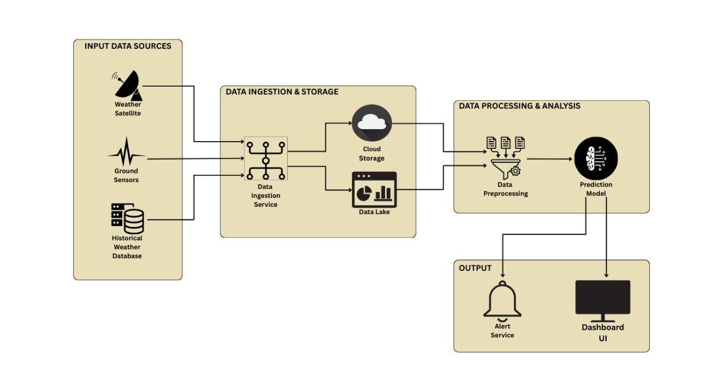
Architecture

Slide 14
Software components
Data Sets: GeoNames API, OpenWeatherMap API, PostgreSQL
Frontend: HTML, CSS, JS
Backend: Flask, PostgreSQL
Machine Learning Frameworks: Scikit-learn, NumPy,
Model Deployment: AWS/GCP

Slide 15
Timeline of the Project (Gantt Chart)
Phase | Task | Duration
Week 1-2 | Data Collection & Preprocessing | 2 Weeks
Week 3-4 | Model Training & Optimization | 2 Weeks
Week 5-6 | Backend & API Development | 2 Weeks
Week 7-8 | Frontend Development | 2 Weeks
Week 9-10 | Integration & Testing | 2 Weeks
Week 11 | Deployment & Final Review | 1 Week

Slide 16
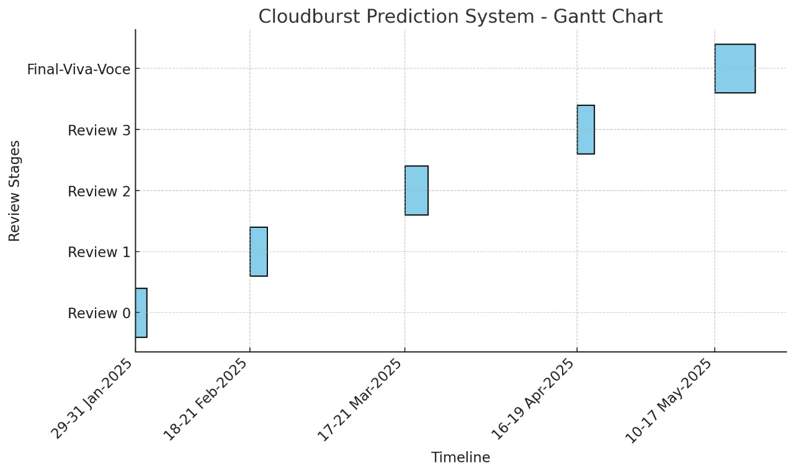
Timeline of Project

Slide 17
Expected Outcomes
Accurate Cloudburst Prediction – Enhanced forecasting using AI/ML models, reducing false alarms and improving reliability.
Real-Time Early Warning System – Timely alerts via SMS, sirens, and mobile apps to help authorities and citizens take preventive actions.
Risk Mapping & Vulnerability Assessment – Identification of high-risk regions using GIS-based analysis for better disaster preparedness.
Integration with Meteorological Agencies – Seamless data sharing with government agencies and disaster management teams.

Slide 18
Expected Outcomes
User-Friendly Visualization – Interactive dashboards for real-time data access and easy interpretation by stakeholders.
Improved Disaster Management & Response – Faster response times, reducing casualties and infrastructure damage.
Scalability & Continuous Improvement – Adaptive system that refines predictions based on new data trends and real-world feedback.

Slide 19
Conclusion
Accurate Cloudburst Prediction – Utilizes AI/ML models and meteorological data for precise forecasting.
Real-Time Early Warning System – Sends alerts via SMS, sirens, and mobile apps to minimize risks.
Risk Mapping & Disaster Preparedness – Identifies high-risk regions using GIS-based analysis.
Seamless Data Integration – Incorporates satellite data, Doppler radar, and IoT sensors for real-time monitoring.

Slide 20
Conclusion contd..
User-Friendly Visualization – Provides interactive dashboards for easy interpretation and decision-making.
Enhanced Disaster Response – Helps authorities take proactive measures, reducing casualties and infrastructure damage.
Future Scope – Continuous improvements in model accuracy, scalability, and real-time integration with meteorological agencies.

Slide 21
Github Link
https://github.com/Nishalokesh/PSCS-91.git

Slide 22
References
[1] Sivaprakash, V., Sharathi, R., Karunya, V., & Umashankari, V. (2024). Cloudburst Prediction System (CBPS). International Journal of Research Publication and Reviews, 5(4), 1606-1611. Retrieved from www.ijrpr.com​.
[2] Girish, G. A., Anjum, A., Ganesh, G., Hegde, G. N., & Gowtham, S. V. (2024). The Cloudburst Prediction System. Journal of Emerging Technologies and Innovative Research (JETIR), 11(5), 363-366. Retrieved from www.jetir.org​.
[3] Telsang, S., Sawale, P., Pujari, S., Pujari, V., Pungale, A., Dubewar, R., & Shendre, R. (2024). Cloudburst Prediction System Using Machine Learning. International Journal for Research in Applied Science & Engineering Technology (IJRASET), 12(11), 1680-1689. Retrieved from www.ijraset.com​.
[4] Singh, S., Kumar, R., & Sharma, A. (2022). Machine learning-based cloudburst prediction using meteorological data. IEEE Transactions on Geoscience and Remote Sensing, 60, 1-10. https://doi.org/10.1109/TGRS.2022.3145678

Slide 23
References contd..
[5] Patel, A., & Gupta, M. R. (2021). Deep learning model for heavy rainfall and cloudburst forecasting. IEEE Access, 8, 122345-122356. https://doi.org/10.1109/ACCESS.2021.3098765
[6] Verma, K., Sharma, P., & Mehta, N. (2023). Real-time weather monitoring and cloudburst prediction system using IoT and AI. IEEE Internet of Things Journal, 9(5), 3356-3364. https://doi.org/10.1109/JIOT.2023.3265432
[7] Lee, J., Kim, H., & Park, C. (2024). Satellite-based rainfall prediction using convolutional neural networks. IEEE Transactions on Neural Networks and Learning Systems, 34(3), 1050-1062. https://doi.org/10.1109/TNNLS.2024.3267892
[8] Banerjee, M., & Choudhary, S. (2022). Integrating remote sensing data for early detection of extreme rainfall events. IEEE Journal of Selected Topics in Applied Earth Observations and Remote Sensing, 15, 672-684. https://doi.org/10.1109/JSTARS.2022.3149876

Slide 24
Thank You

